Slide 1
UPS project GROUP 3
Kayla Bayona
Aksarapuk Mullane
Jeremy Wikow
Mohammad Qasem

Slide 2

Agenda
Pseudocode
Python file
Html Input
Html Output

Slide 3
Pseudocode
Initialize the application with the following parameters:
Create the package information
This will use the class method (name,weight,size,originalpoint,destinationpoint,pickuptime,)
Reusable package inventory (check to see if there is a reusable package that is going to be used. We will create the reusable package)
While the application is running:
-create schedule pickup function -para (time, origin point, destination point)
-check if the time is it the pickup regular hour or urgent hour -update the status to “shipped”
-check where is the nearest pickup ups store
-check how far from origin —> ups store this will: update the mileage in package1
-calculate the time estimate time to delivery package to destination point
(origin —> ups store —> destination) Return : status, mileage, estimate delivery
-Update the package's 1Z shipment numbers and store them in the database for future reference

Slide 4
Pseudocode
When a customer wants to track their package:
Create html page and ask the user to input tracking number
Show information about the package
When a package has been delivered:
If the package has been the delivery when the user input the tracking number and status show that it’s delivered ,
-prompt pop up that ask the user to rate the system 1-5 star and also write the review if they want. This will store in the database

Slide 5
Package flow
Origin
The driver pick up the package in from the schedule
UPS store
UPS staff input information into database
If destination nearby the last ups store then the driver will delivery
If the destination is far from the ups store than it will send to another ups store and and process delivery
Destination
delivery
UPS store
UPS store

Slide 6
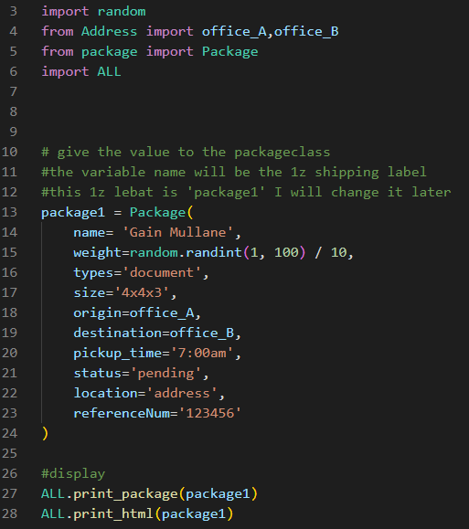
Main.py
This page will connect with HTML file that ups staff can input the information about the package

Slide 7
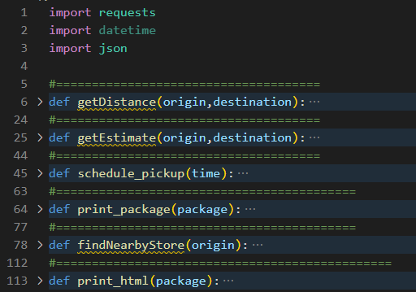
ALL.py
This file contains the function that calculate the distance from origin to nearby ups store to destination
Function that calculate the estimate time to delivery
Function that find ups stror nearby using google api
The schedule pickup time
Print the result in terminal
Print the result to html file

Slide 8
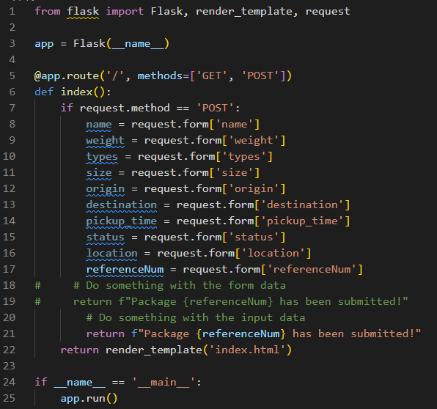
app.py
This file we use python that import flask to use get input from html
This file will replace for the main.py

Slide 9
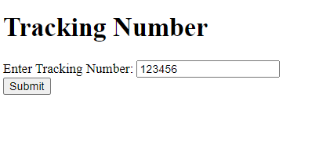
Tracking number page

Slide 10
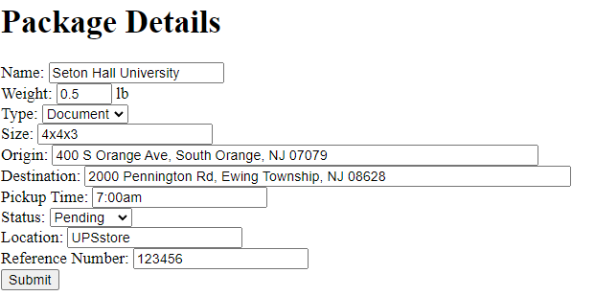
Package details
With PowerPoint, you can create presentations and share your work with others, wherever they are. Type the text you want here to get started. You can also add images, art, and videos on this template. Save to OneDrive and access your presentations from your computer, tablet, or phone.

Slide 11
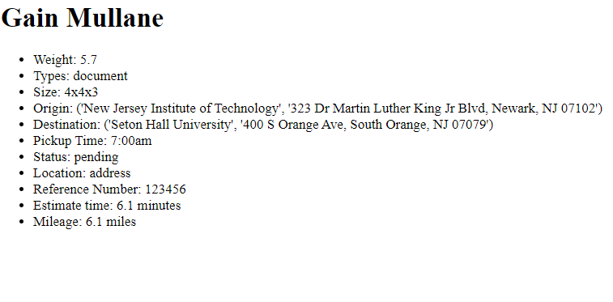
Output
Name Title
Name Title
Name Title
Name Title

Slide 12




Thank you

